Slide 1


Competition Analysis
DLR Guest Communications Recap

Slide 2

2023 Canoe Races: Overall Summary
Event Summary
Teams race to compete into four divisions within 8 weeks. The teams race each other, until becoming the overall winner.
Race Divisions
Missouri Division
Rio Grande Division
Columbia Division
Mississippi Division
Race Events
June 19th, 2023 – August 10th, 2023
Race Teams
143 Teams
2
DLR Guest Communications Recap on 2023 Disneyland Resort Cast Member Canoe Races.

Slide 3
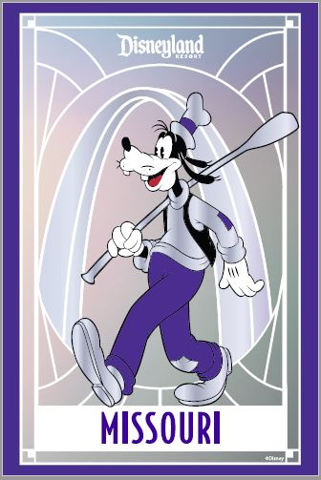
2023 Canoe Races: Missouri Division
Teams
17 teams started in this division, by the semi finals only 6 teams made it.
Race Times
Race Week: DC Gorilla Oarfare - 03:45.90, Smoke On The Water – 04:03.30 & DC Gods of Oar – 04:09.00
Quarter Finals: DC Gorilla Oarfare – 03:59.60, Smoke On The Water – 04:07.20 & You're Welcome – 04:07.30
Semi Finals: DC Gorilla Oarfare – 03:53.60, Smoke On The Water – 03:58.30 & DC Gods of Oar – 04:02.90
Division Winner
DC Gorilla Oarfare – 03:58.20
3
DLR Guest Communications Recap on 2023 Disneyland Resort Cast Member Canoe Races.

Slide 4
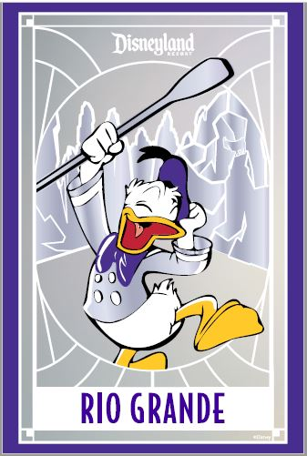
2023 Canoe Races: Rio Grande Division
Teams
19 teams started in this division, by the semi finals only 6 teams made it.
Race Times
Race Week: TRI & Keep Up – 04:37.60, Plaidstics – 04:38.50 & the standing 50 – 04:40.10
Quarter Finals: 3rd Shift Raccoons – 04:21.60, Plaidstics – 04:30.80 & Racing Rancors – 04:33.90
Semi Finals: Racing Rancors – 04:22.00, Row-sort Enhancers – 04:22.40 & Paddilacs – 04:23.40
Division Winner
Racing Rancors – 04:25.30
4
DLR Guest Communications Recap on 2023 Disneyland Resort Cast Member Canoe Races.

Slide 5
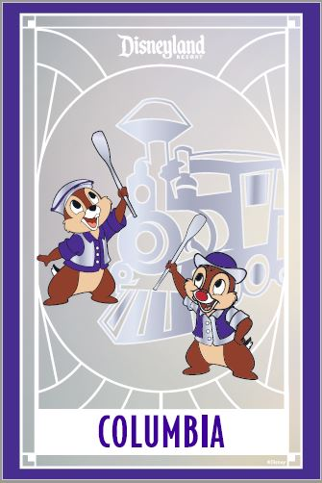
2023 Canoe Races: Columbia Division
Teams
20 teams started in this division, by the semi finals only 6 teams made it.
Race Times
Race Week: Great Pacific Garbage Boat – 04:57.10, Nouveau Navy – 04:58.50 & Toasted Blueberries – 04:58.70
Quarter Finals: Great Pacific Garbage Boat – 04:36.60, Change OARder?! We're ROWver Budget! – 04:40.70 & A-Row-Ha – 04:41.00
Semi Finals: Great Pacific Garbage Boat – 04:20.00, Change OARder?! We're ROWver Budget! – 04:26.90 & Rivers of FAMerica – 04:27.20
Division Winner
Rivers of FAMerica – 04:18.80
5
DLR Guest Communications Recap on 2023 Disneyland Resort Cast Member Canoe Races.

Slide 6
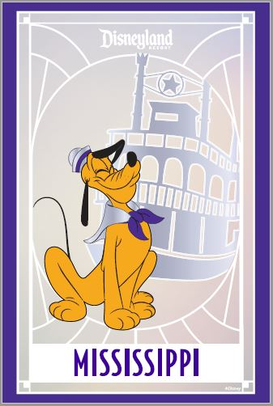
2023 Canoe Races: Mississippi Division
Teams
20 teams started in this division, by the semi finals only 6 teams made it.
Race Times
Race Week: Misfit Magic Makers – 05:25.60, Rows & Columns – 05:27.30 & The Rowling Stones – 05:29.60
Quarter Finals: 3rd Shift Trash Pandas – 05:07.40, AnimatOARS – 05:20.00 & Guest Rowlations – 05:26.30
Semi Finals: 3rd Shift Trash Pandas – 05:00.80, Batuuan Canuuans – 05:20.00 & Guest Rowlations – 05:23.10
Division Winner
3rd Shift Trash Pandas – 04:40.80
6
DLR Guest Communications Recap on 2023 Disneyland Resort Cast Member Canoe Races.

Slide 7
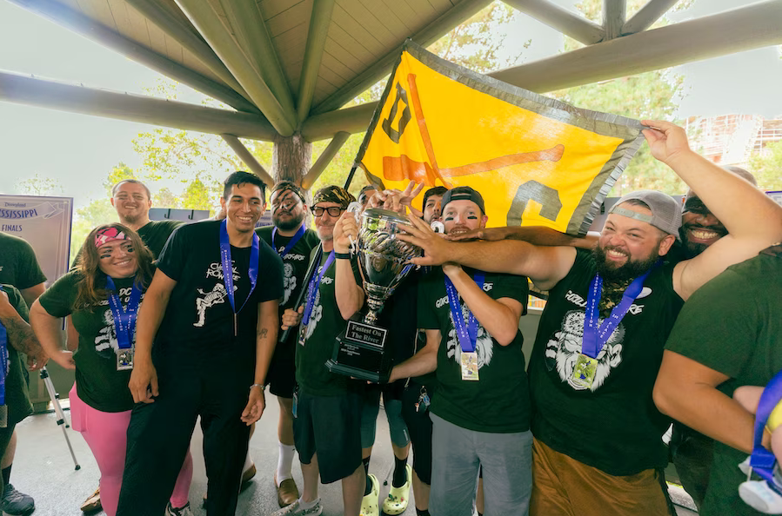
2023 Canoe Races: Winner Result
DC Gorilla Oarfare are the 2023 Canoe Races Champions
7
DLR Guest Communications Recap on 2023 Disneyland Resort Cast Member Canoe Races.

Slide 8
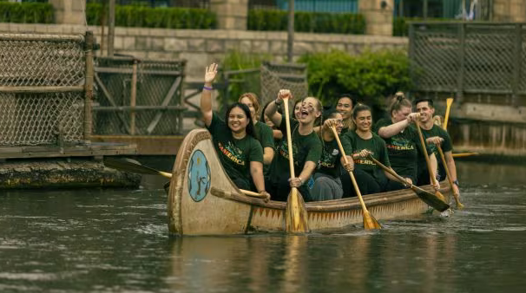
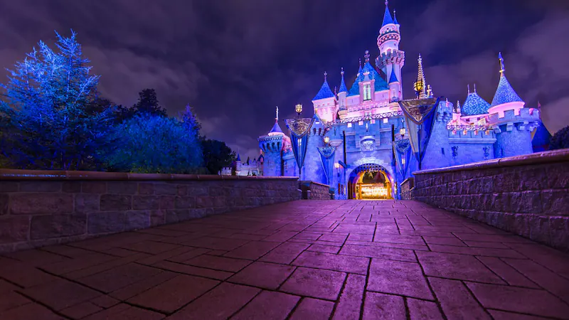
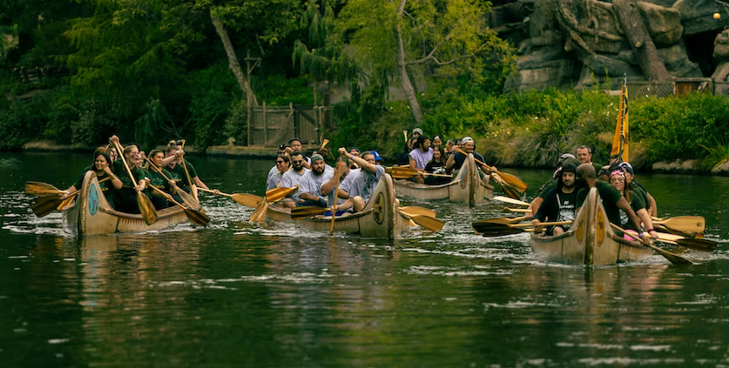
Questions?
Please contact the Guest Communications Reporting Team with any questions.
#DLR-DL Guest Comm Reporting Team

